Slide 1
Gensim with Keras
Presenter: Surbhi Arora

Slide 2

Presenter :Surbhi Arora
Joined CCC Data Science Team January, 2017 as an intern
Full Time Data Scientist, June 2017
Masters in Computer Science from University of Illinois at Chicago
Interests:
Machine Learning
Natural Language Processing
Coding
Dancing

Slide 3
Gensim
Topic modeling for humans
It is the most robust and efficient library that specializes in vector space and topic modeling.
In order to run any mathematical model on text corpus, it is a good practice to convert it into a matrix representation.
Gensim is one such clean and beautiful open-source Python library to handle text data.
Our python notebook demo include Natural Language Processing applications using Gensim Word2Vec with Keras.

Slide 4
Word2Vec
Motivation for Word2Vec
One way of changing sentences to matrix would be to use a “one-hot” method of converting the word into a sparse representation with only one element of the vector set to 1, the rest being zero.
In practical applications, machine and deep learning models are going to learn from gigantic vocabularies i.e. more than thousands words.
Hence, using “one hot” representations of the text is not efficient
Another issue is one hot encoding losses contextual meaning of the word

Slide 5
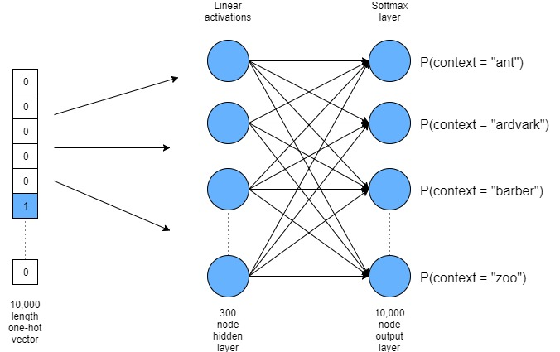
Softmax Trainer for word embedding

Slide 6
Negative Sampling
The problem with using a full softmax output layer is that it is very computationally expensive.
Negative Sampling works by reinforcing the strength of weights which link a target word to its context words, but rather than reducing the value of all those weights which aren’t in the context, it simply samples a small number of them – these are called the “negative samples”.
Now, instead of thousands nodes output for each word, network will output a ‘1’ for words that are in the context of the target word , and for our negative samples, network will output a ‘0’.
Therefore, the output layer of our Word2Vec network is simply a single node with a sigmoid activation function.

Slide 7
Packages Required
Python >= 3
NumPy >= 1.3
SciPy >= 0.7
Jupyter Notebook
Sklearn
Tensorflow
Keras
Gensim

Slide 8
References
Softmax http://ruder.io/word-embeddings-softmax/
Keras Word2Vec http://adventuresinmachinelearning.com/word2vec-keras-tutorial/
Gensim Word2Vec https://radimrehurek.com/gensim/models/keyedvectors.html https://radimrehurek.com/gensim/models/word2vec.html
Dataset http://mattmahoney.net/dc/
Twitter Sentiment Analysis https://ahmedbesbes.com/sentiment-analysis-on-twitter-using-word2vec-and-keras.html

Slide 9
Thank You!

